Slide 1
Shark Attacks

Slide 2
Project Description:
A shark attack database was downloaded from Kaggle.com and data cleaning was performed. The clean data was then used to create a dashboard with several shark attack statistics around the globe. The shark attack data is also presented in geographic and tabular formats. The following technologies were used in the project: Python Pandas Javascript D3 Plotly Chart.js
Leaflet
Map Box

Slide 3
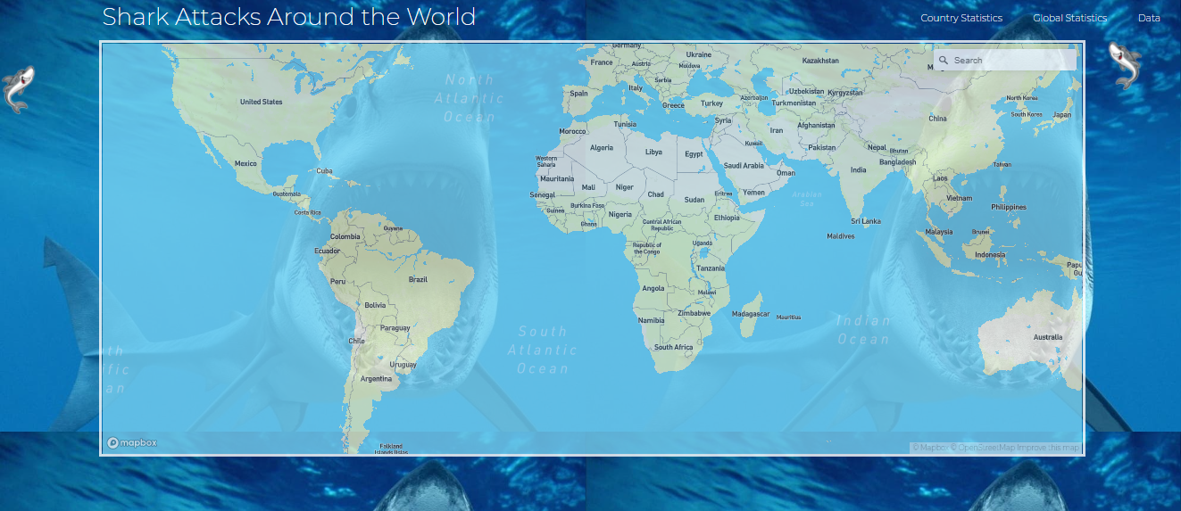
Dashboard:

Slide 4
Dashboard:
We have main dashboard where we can search multiple countries in map.

Slide 5
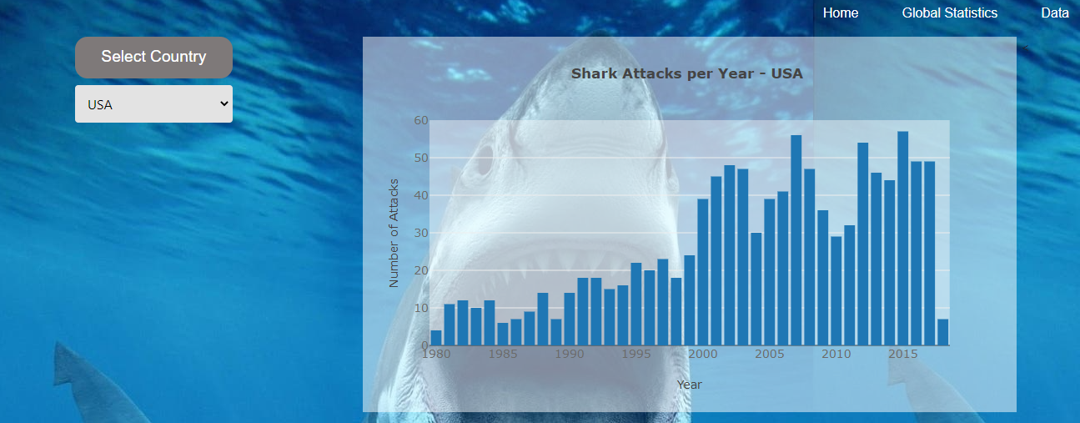
Country Stats: (Bar Chart)

Slide 6
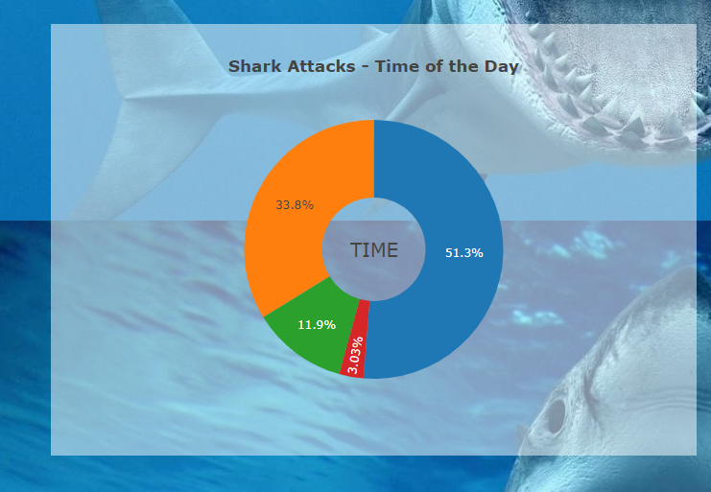
Country Stats: (Pie chart)

Slide 7
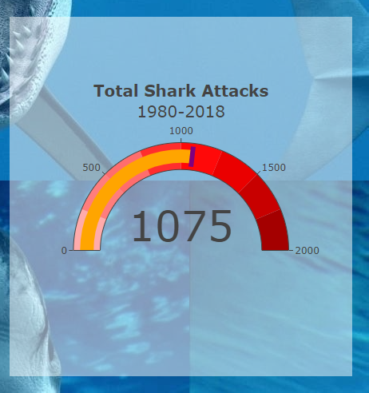
Country Stats: (Gauge)

